Slide 1
DSA MINI PROJECT
-Library Management System

Slide 2
THE TEAM
1)Neha.Girish PES2UG22CS346
2)Meghana.N PES2UG22CS341
3) Nikhita.G PES2UG22CS359
4) Nida.Fathima PES2UG22CS353

Slide 3
FEATURES
1)Contact Information of the Library
2)Book Issuing
3)Book Returning
4)Display Student Details

Slide 4
PROJECT SYNOPSIS
This DSA Mini-Project is a simple student library system. We used linked list to manage books and student records. Users can initialize the library, borrow and return books, and view student details through a command-line interface. This code includes structures for books and students, functions for library operations, and a main menu for user interaction. This project offers a fundamental example of a library management system in C.

Slide 5
PROJECT DESCRIPTION
→Header Files
studio.h - standard input/output
conio.h - console based input/output
stdlib.h,malloc.h - Memory Allocation
string.h - String manipulation

Slide 6
PROJECT DESCRIPTION
→Main Functions Used:
book_issue() - handles the issuance to the students
book_return() -handles the return of books from students
display() - displays details of students who have issued books
delete_book() - deletes a book from the library based on its ID
add_book() - adds a new book to the library

Slide 7
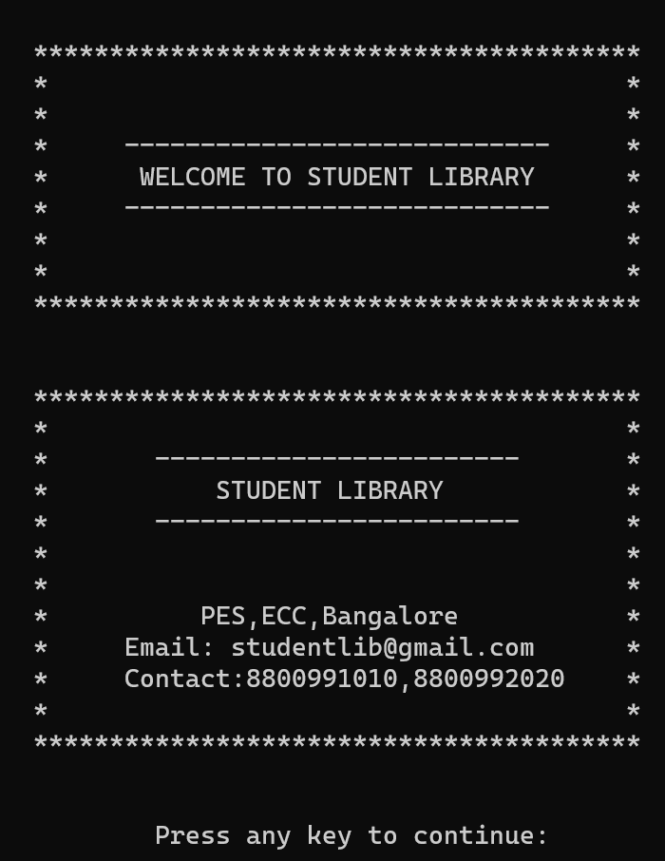
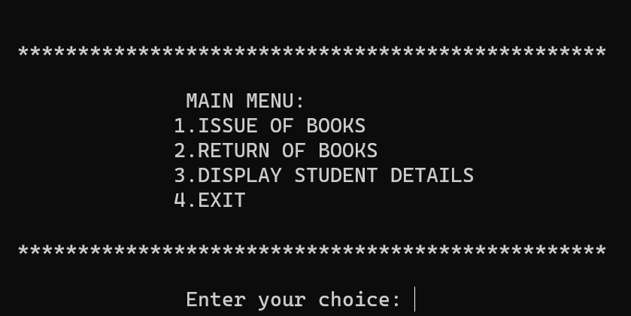
SAMPLE OUTPUT
s

Slide 8
THANK YOU

